Slide 1
USS CROAKER
SSK 246
WWII Gato Class
Guppy Conversion to Cold War Hunter/Killer

Slide 2
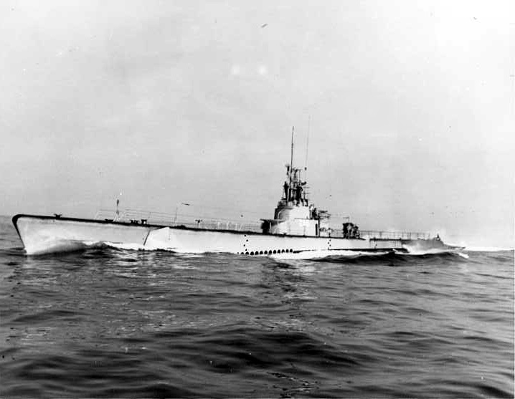
Gato Class

Slide 3
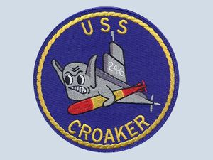
WWII Patch
https://www.usmilitariaforum.com/forums/index.php?/topic/310637-wwii-equator-crossing-sub-skipper-uss-croaker/

Slide 4
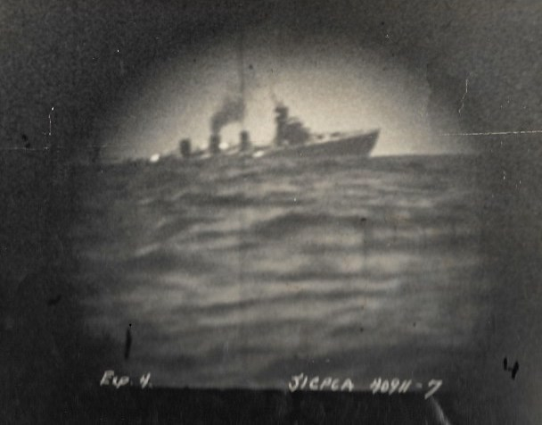
IJN NAGARA – Cruiser Sinking Scope Pic

Slide 5
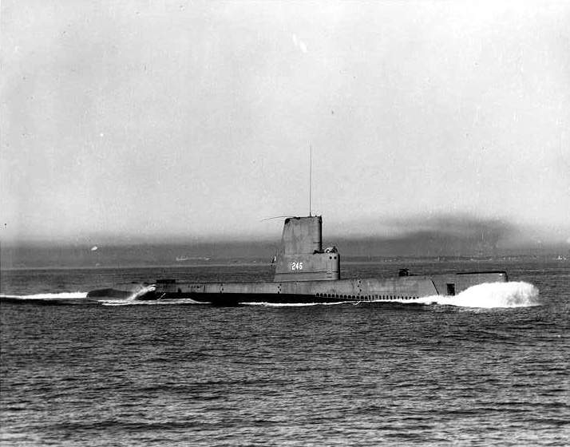
Guppy Conversion

Slide 6
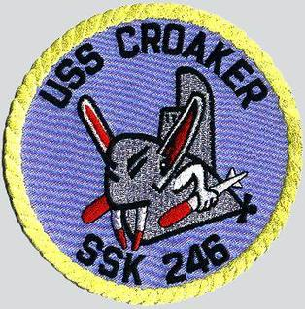
SSK Patch
https://www.youtube.com/watch?v=5f03m7tVBw8

Slide 7
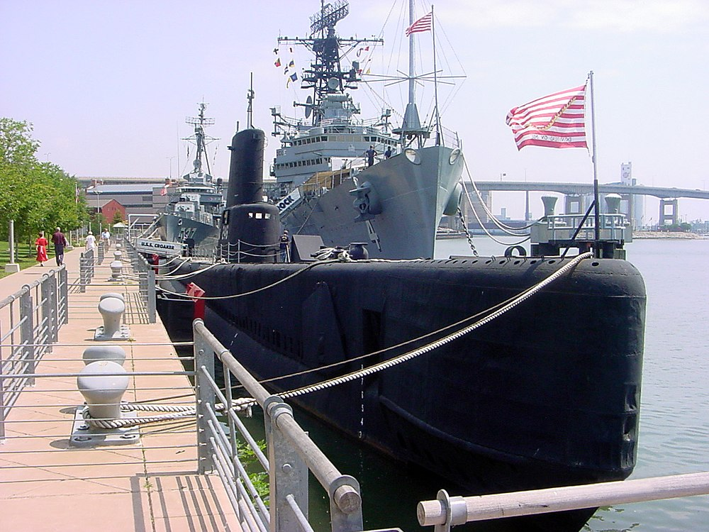
Museum Boat – Buffalo, NY

Slide 8
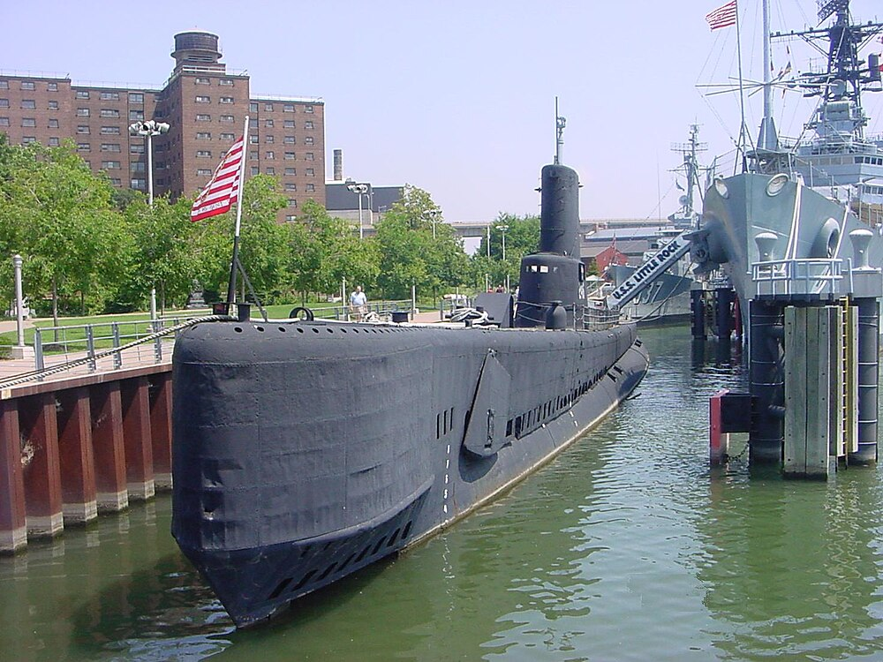

Slide 9
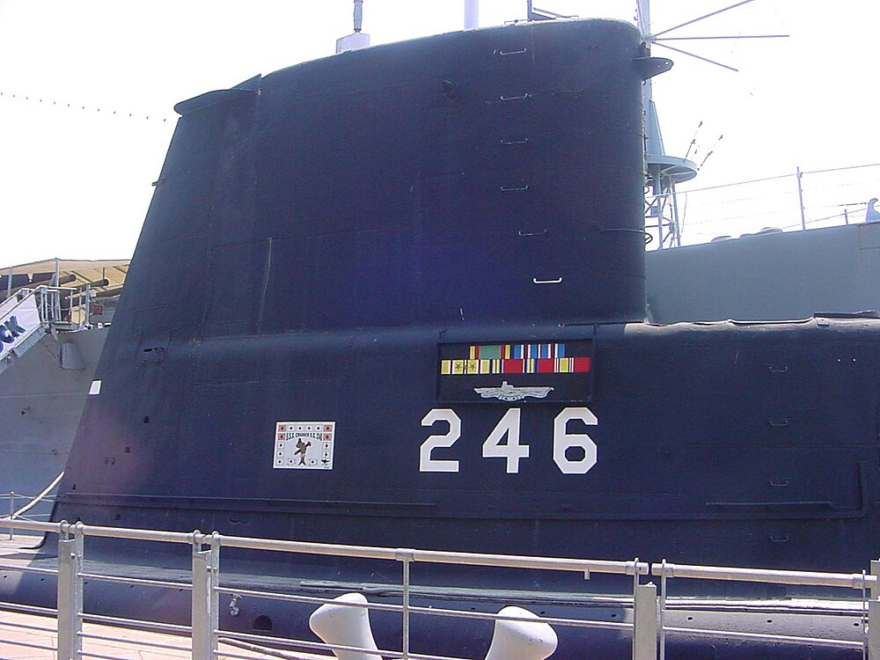

Slide 10
